Slide 1

Perform Exploratory Data Analysis (EDA)

Slide 2
About me
Background-Bachelor of Engineering (BE), Artificial Intelligence and Data Science Engineering from SHAH AND ANCHOR KUTCHHI ENGINEERING COLLEGE(Mumbai)
Why you want to learn Data Science-An individual with a strong enthusiasm for data, My curriculum is centered around machine learning and data science so I try my best of my ability to address real-world problems and my soft skills include good listening skill and problem solving.
Any work experience-Nan
Share your linkedin and github profile urls- www.linkedin.com/in/chinnakrishna

Slide 3
Business Problem
Performing Exploratory Data Analysis (EDA) on the data-set and also Performing Hypothesis testing on the given dataset.
Objective of the Project
Performing:-
Univariate Analysis
Bivariate Analysis
Research Questions
Times of India article dated Jan 18, 2019 states that “After doing your Computer Science Engineering if you take up jobs as a Programming Analyst, Software Engineer, Hardware Engineer and Associate Engineer you can earn up to 2.5-3 lakhs as a fresh graduate.” Test this claim with the data given to you.
Is there a relationship between gender and specialization? (i.e. Does the preference of Specialisation depend on the Gender?)

Slide 4
Exploratory Data Analysis:
Data Cleaning Steps Dropping Irrelevant column
Data Manipulation and Transformation Steps Changing datatypes of columns Normalizing the data Dropping repeated data and using replace for data manipulation

Slide 5
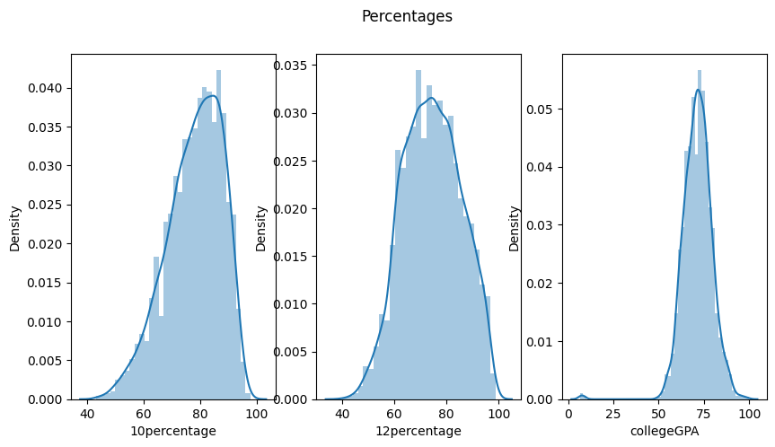
Univariate Analysis
Data for 10thBoard percentage,12thBoard percentage,CGPA is normally distributed with mean 77.9254427213607,74.46636568284141 ,71.48617058529265 respectively

Slide 6
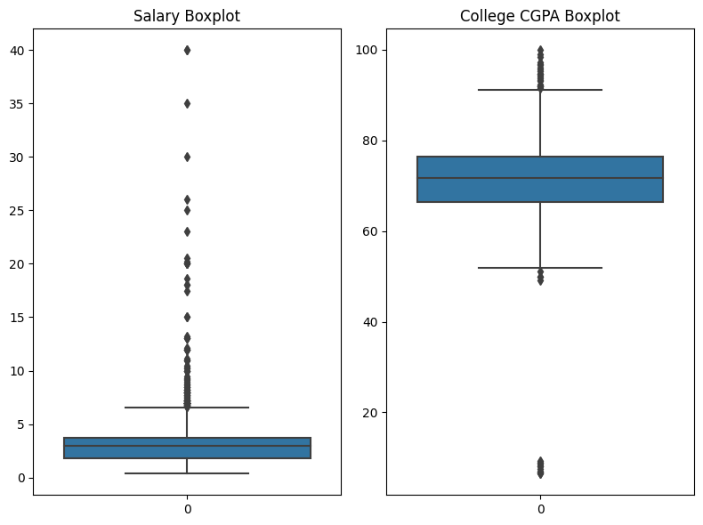
Univariate Analysis
Range for CollegeGPA is 66.4 to 76.33 for IQR of 25 to 75 and Range for Salary is 180000 to 370000 for IQR of 25 to 75

Slide 7
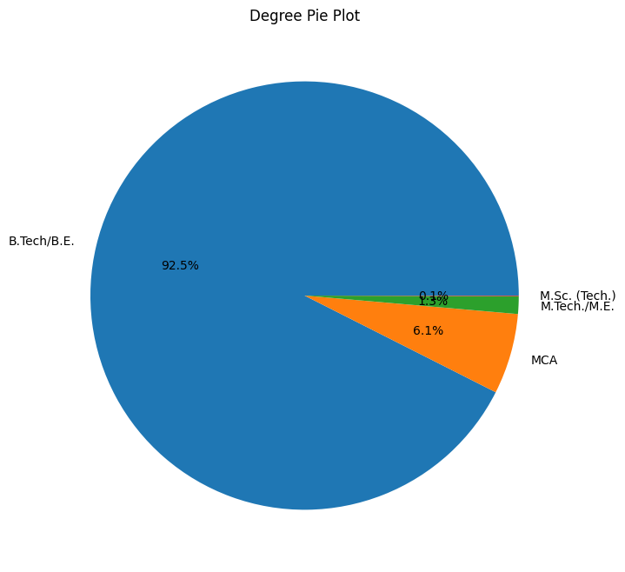
Univariate Analysis
most people have done b.tech/b.e. followed by mca,m.tech./m.e.,m.sc. (tech.)

Slide 8
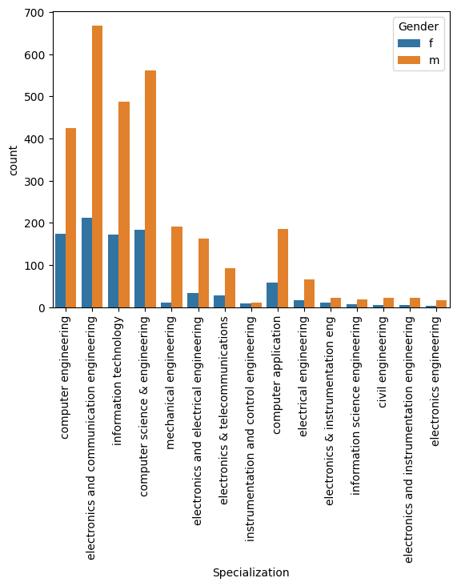
Bivariate Analysis
Top 15 Specialization with hue male,more male person has enrolled for course

Slide 9
Conclusion for cases CASE1-Accept the Hypothesis that you can earn up to 2.5-3 lakhs as a fresh graduate for jobs as a Programming Analyst, Software Engineer, Hardware Engineer and Associate Engineer. CASE2-Accept the Hypothesis that there is a relationship between gender and specialization

Slide 10

THANK YOU

